Slide 1


Carbon and Oxygen dripline in Nuclear Lattice Effective Field Theory
Young-Ho Song (IRIS, IBS)
NLEFT collaboration
2nd Korea-Japan Nuclear Physics Workshop, 2023.11.13, IBS, Daejeon

Slide 2
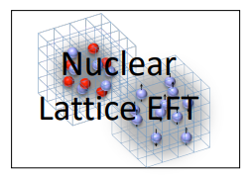
Nuclear Lattice Effective Field Theory Collaboration
Serdar Elhatisari(Gaziantep Islam Science and Technology)
Lukas Bovermann(Ruhr)
Evgeny Epelbaum (Bochum)
Dillon Frame (Juelich)
Fabian Hildenbrand(Darmstadt)
Hermann Krebs(Ruhr)
Timo A. Lähde (Juelich)
Dean Lee (MSU)
Ning Li(Sun Yat-sen)
Bing-Nan Lu( Graduate School of China Academy of Engineering Physic)
Myungkuk Kim(CENS,IBS)
Youngman Kim (CENS,IBS)
Young-Ho Song(IRIS,IBS)
Yuanzhuo Ma(Peking)
Ulf-G. Meißner (Bonn/Juelich)
Gautam Rupak(Mississippi State)
Shihang Shen (Juelich)
Gianluca Stellin( CEA Paris-Saclay)
And More…

Slide 3
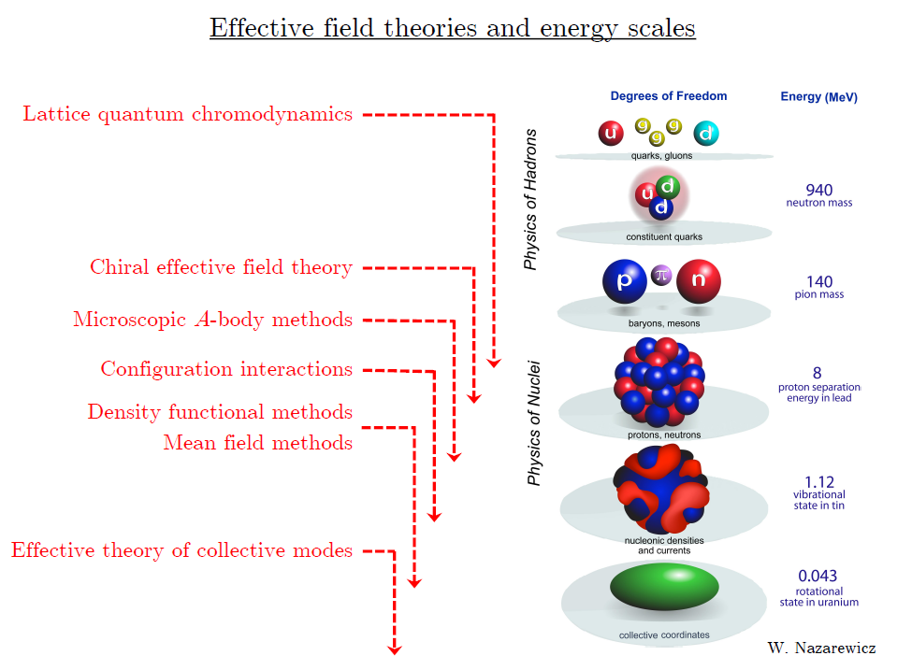
Ab initio
Nuclear
Theory

Slide 4
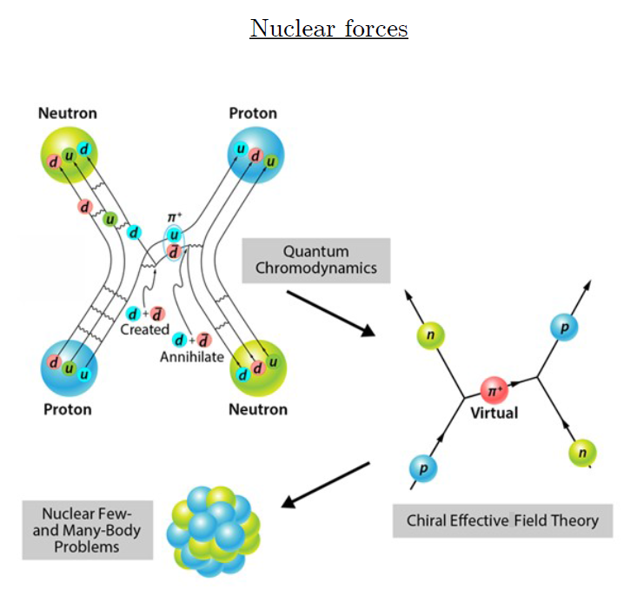
Ab-initio method
ab-initio Nuclear Physics
(1) nucleon degrees of freedom
(2) nucleon-nucleon interaction
Goal: predict wide range(structure, reaction, nuclear matter) of nuclear phenomena (without parameter fitting, model assumption) from nuclear interaction (for 2-body,3-body, many-body, based on QCD)
Direct connection between
Nuclear Force ↔ Nuclear Phenomena

Slide 5
Ab initio many-body
(ab initio) Nuclear physics is challenging.
Non-perturbative many body problem
Ab-initio nuclear many body methods
Greens function Monte Carlo(GFMC)
No-core shell model(NCSM)
Coupled Cluster (CC)
IM-SRG, VS-SRG
Nuclear Lattice Effective Field Theory(NLEFT)
And more
With recent progress in ab-initio methods
Binding energies for wide range of nuclei
Some reaction calculation for light nuclei.

Slide 6
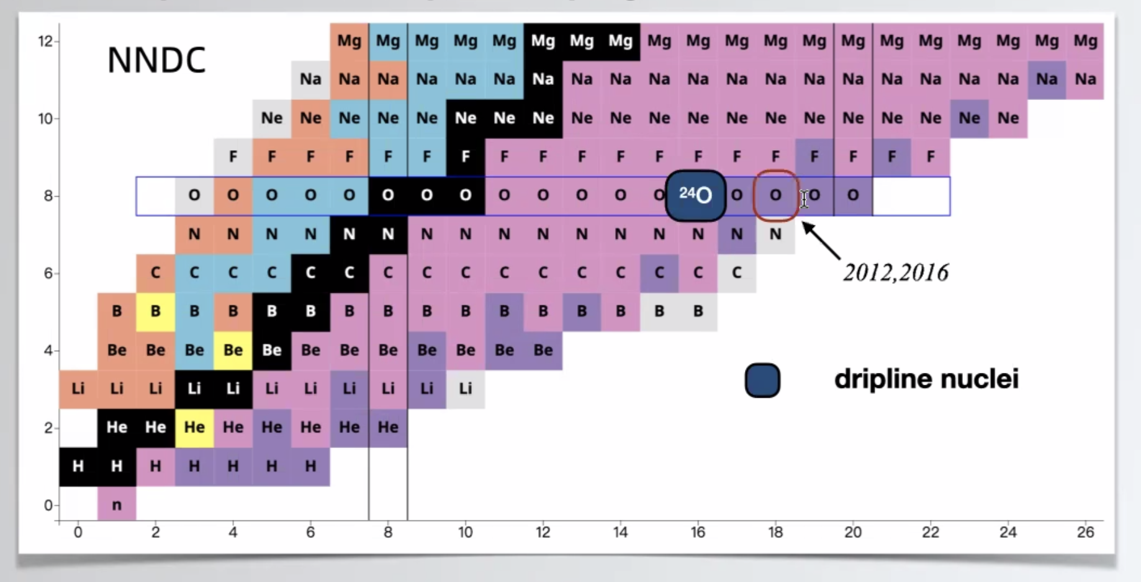
Dripline
Can we explain the dripline of Carbon, Oxygen isotopes in NLEFT?
Sensitive to nuclear force ? (Role of 3-body force?)

Slide 7
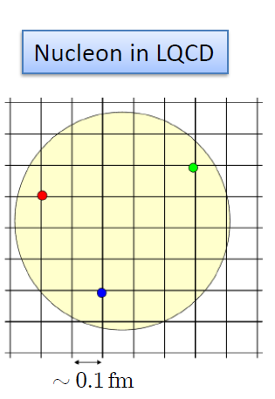
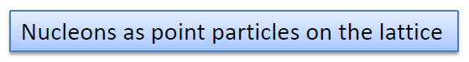
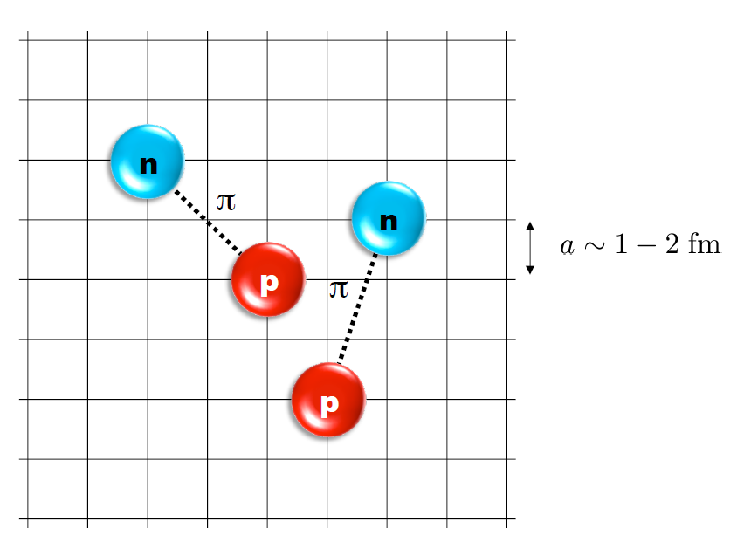
Nuclear Lattice Effective Field Theory
One of ab initio method for many fermion system

Slide 8
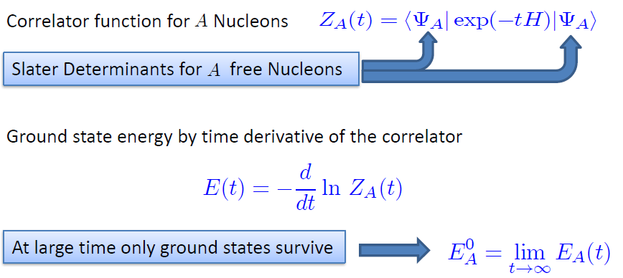
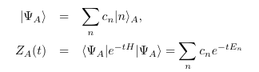
Path integral

Slide 9
Lattice Hamiltonian
We need to introduce a lattice scale in space and time:
momentum space cutoff ~ 150 MeV → lattice size a= 1.316 fm
Time cutoff ~ 1000 MeV
We need to determine coefficients of interaction for the lattice size. (regularization scale.)
Two-body interaction coefficients can be determined from phase shifts of np scattering.
Three-body interaction can be fixed from binding energy of A>=3.

Slide 10
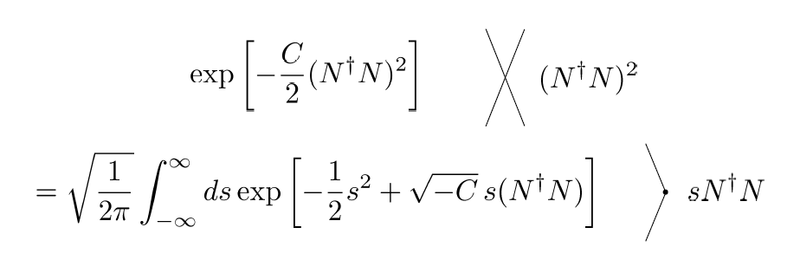
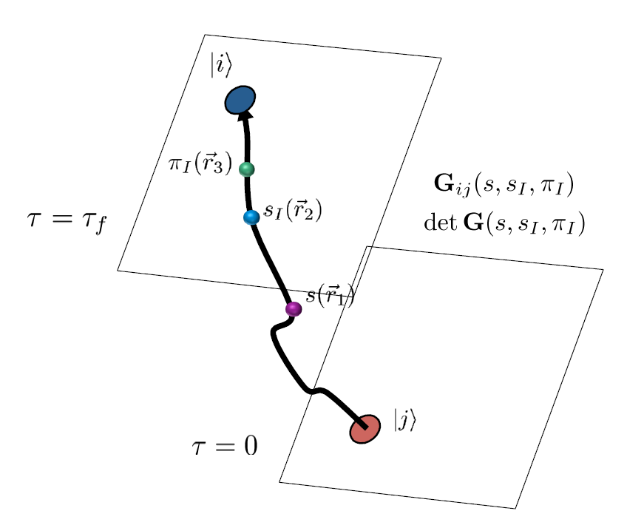
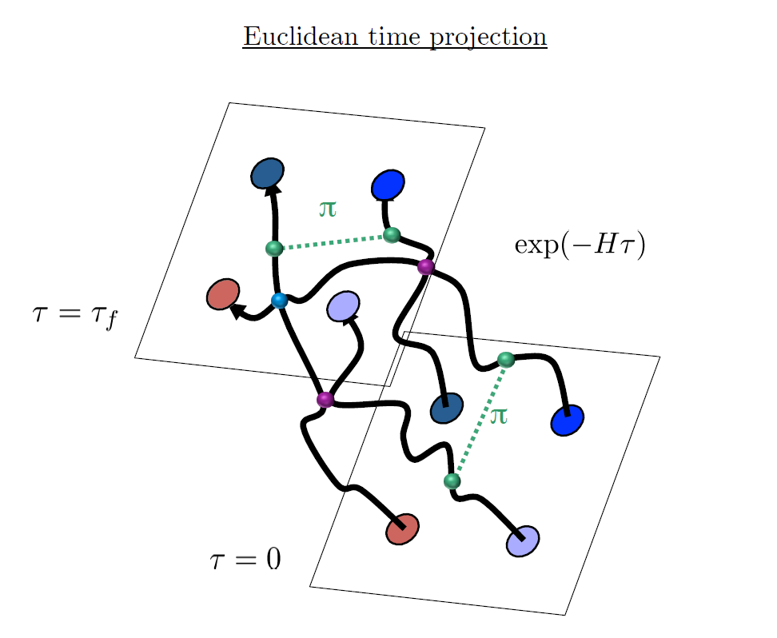
Auxiliary Field Monte Carlo

Slide 11
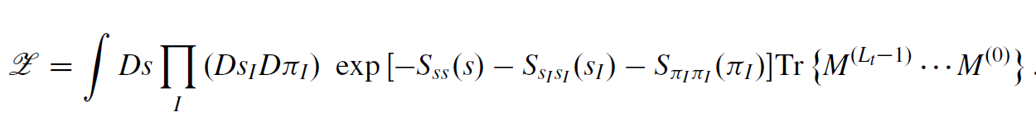
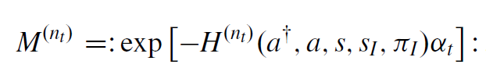
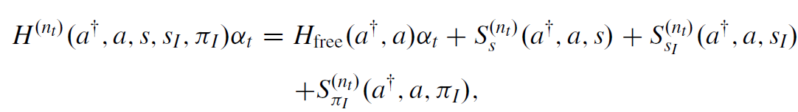
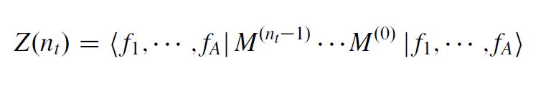
Hamiltonian in auxiliary field lattice
compute fermion amplitude
Integration over auxiliary fields
M.C. integral

Slide 12
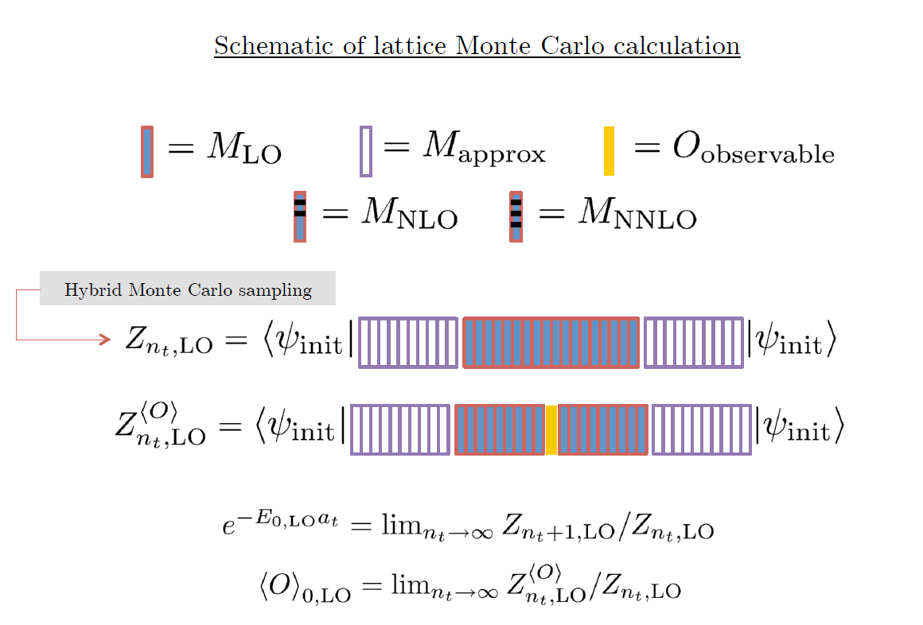

Slide 13
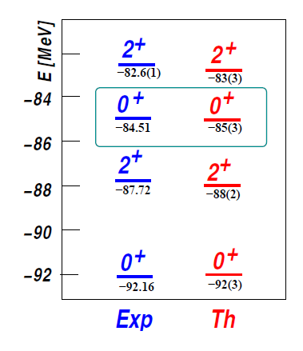
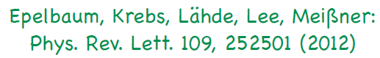
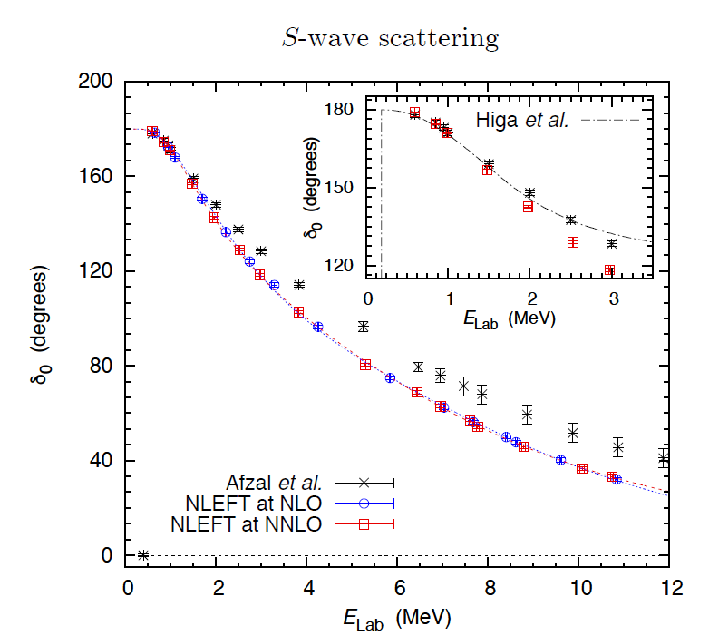
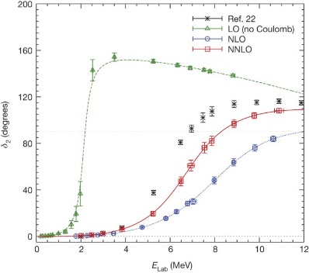
Applications of NLEFT
The first ab-initio calculation of
Hoyle state
Has been successfully applied to
Nuclear matter, Cold atom, dilute fermion system
Finite nuclei (A<=50)
First ab-initio calculation of Hoyle state
Cluster structure of ¹²C and ¹⁶O
NN scattering, N-D scattering
Alpha-alpha scattering
radiative capture, fusion
Etc.
Ab initio alpha-alpha scattering
( Nature 528, 111-114(2015))

Slide 14
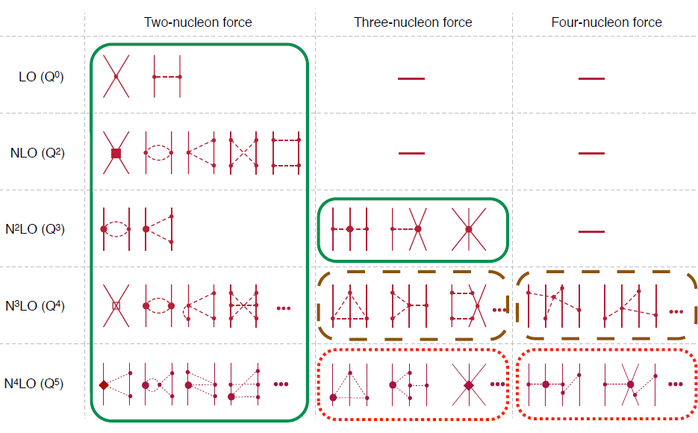
Chiral Effective Field Theory

Slide 15
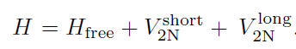
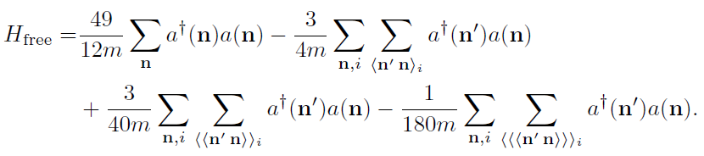
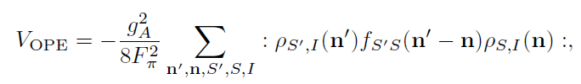
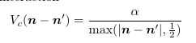
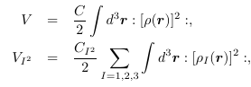
Lattice chiral Hamiltonian at Leading order
At Leading order, kinetic energy + contact interaction + one pion exchange
Kinetic
Long range OPE
(Perturbative) Coulomb
Contact

Slide 16
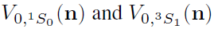
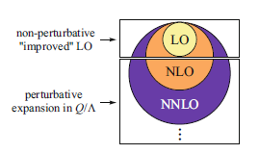
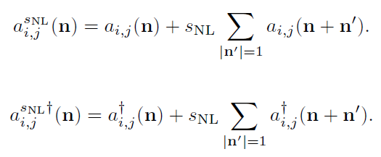
Improved action with non-locality
In practical calculation, sign problem and convergence of perturbation have to be taken care of.
To improve the non-perturbative calculation,
Local and non-local smearing of contact interaction are introduced.

Slide 17
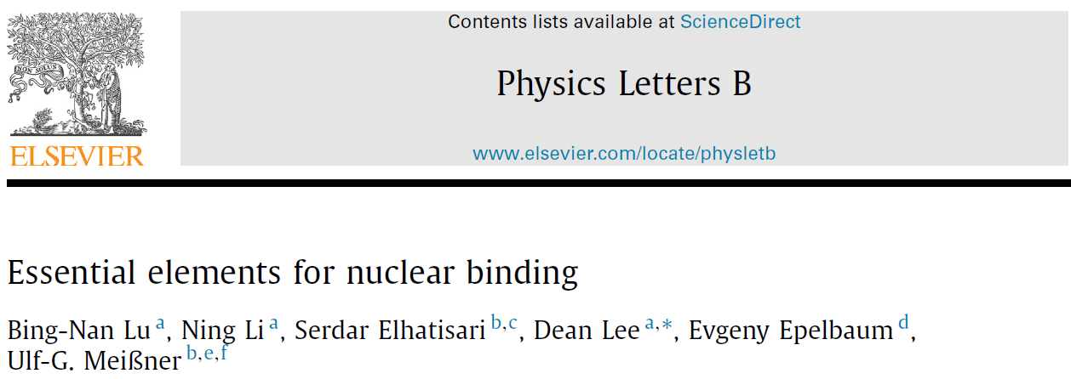
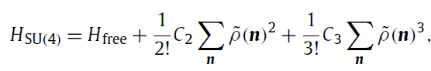
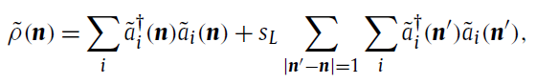
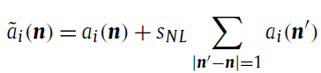
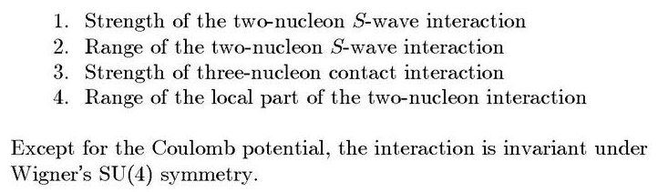
Minimal nuclear interaction
Which reproduce
Light nuclei
medium mass nuclei
neutron matter
simultaneously up to few percent error in binding energy and charge radius
Only Four parameters

Slide 18
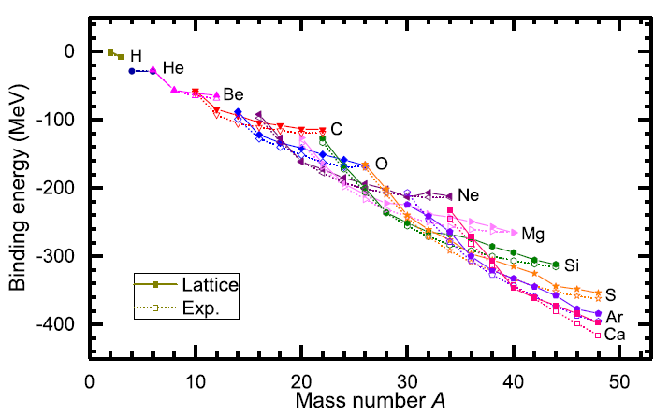
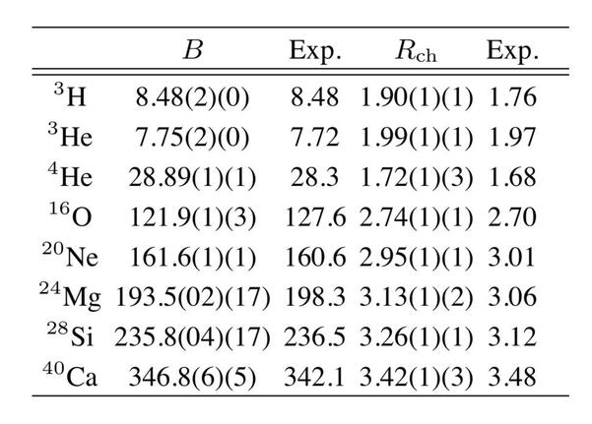
Can we improve the agreement by
Including higher order corrections?

Slide 19
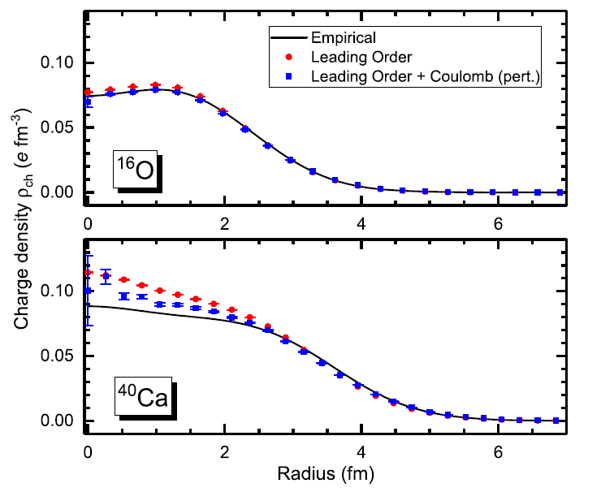
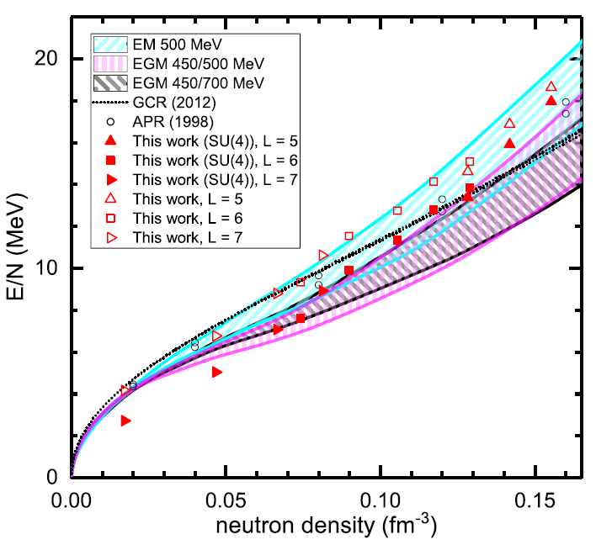
Can we improve the agreement by
Including higher order corrections?

Slide 20
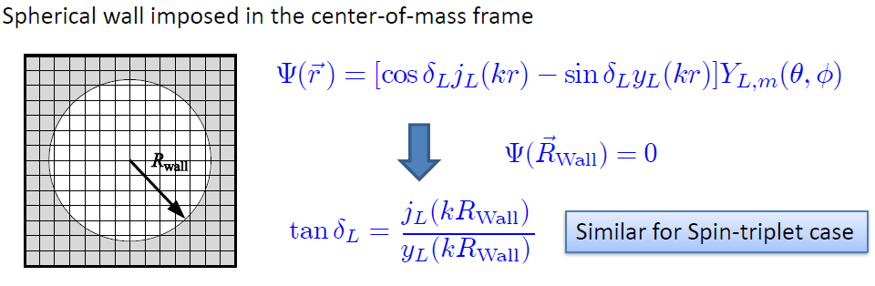
Low energy constants in lattice EFT
All LECs(parameters in the Hamiltonian) needs to be fixed
(They have to be fixed for given lattice regularization)
N-P scattering phase shifts, Deuteron binding energy
Triton binding energy, Triton beta decay.
Scattering phase shifts on the Lattice: Wall method.
Phase shift can be obtained from
The energy spectrum of E(or k) in lattice and imposed Wall size.

Slide 21
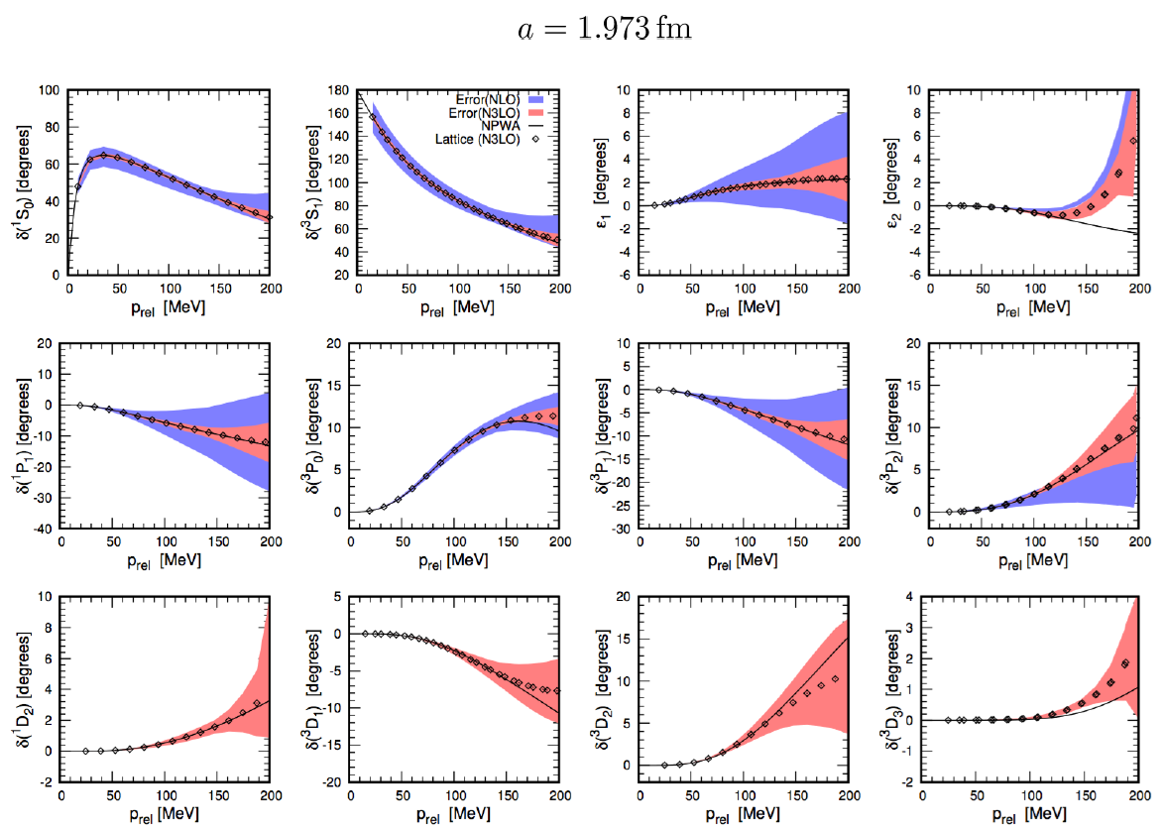
Determine LECs by fitting phase shifts of N-N scattering

Slide 22
Lattice chiral Hamiltonian (N3LO)
Full N3LO Hamiltonian includes
Free Hamiltonian(Kinetic term)
Short range (nonlocal smeared) contact interactions up to Q^4 order
Isospin-breaking short range interactions
One pion exchange potential
Two pion exchange potential up to Q^4 order
Coulomb interaction
Long range isospin breaking interaction( isospin dependence in OPE)
Galilean Invariance Restoration (GIR) term (because of non-local interaction.)
Three nucleon interaction

Slide 23
Difficulty with full chiral interaction
Sign problem
NLEFT suffers sign problems at large Euclidean time limit
Large cancellation between positive and negative contributions→ large uncertainty.
SU(4) symmetric interaction does not have sign problem
One pion exchange and higher order chiral interaction
Difficulty with Asymmetric nuclei
Needs a remedy to extend to neutron rich isotopes.
A new approach to reduce the sign problem.
→ Wave function matching Hamiltonian.

Slide 24
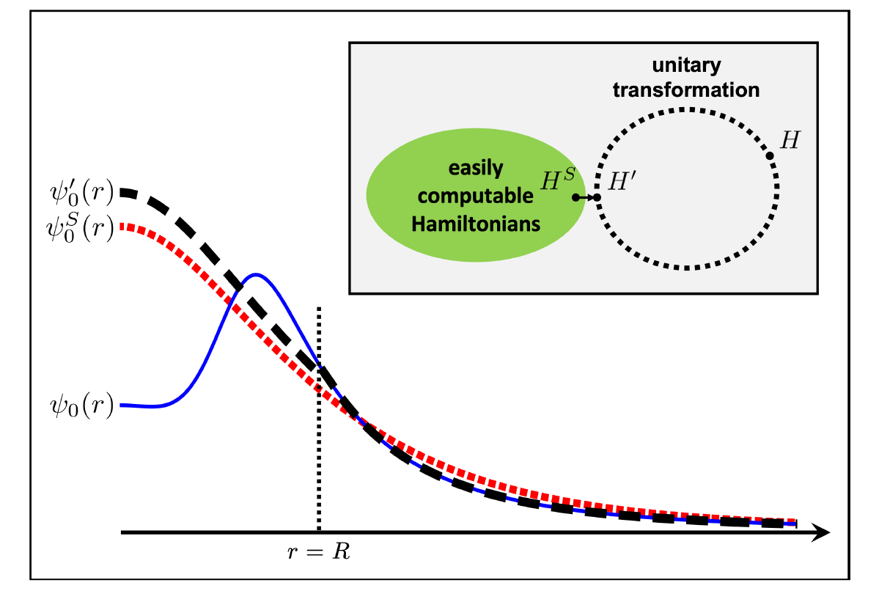
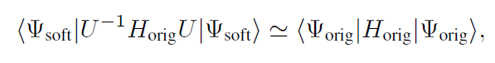
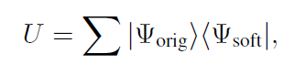
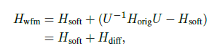
Wave function matching
H and H’ are fully equivalent to two-body observables
The goal is to make the perturbation expansion from “simple” wave function gives a good convergence
U is only active
At r < R

Slide 25
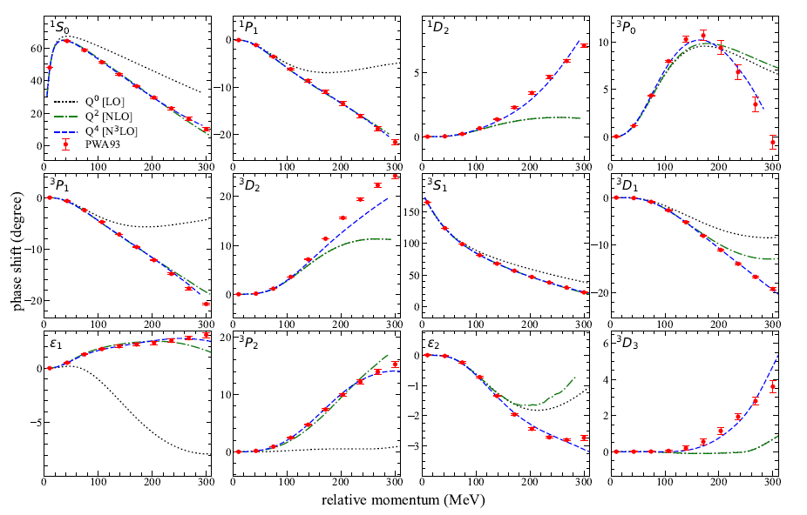
NN phase shifts from WFM
Original Hamiltonian is fitted to phase shifts.
H’ is equivalent to original Hamiltonian.

Slide 26
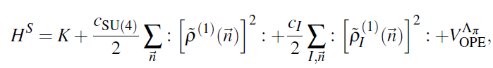
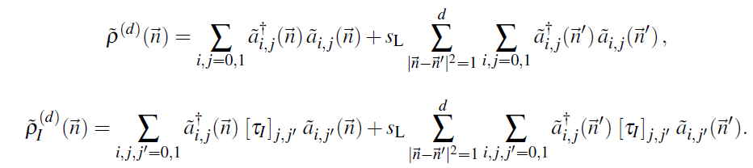
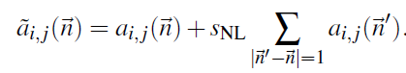
Wave function matching Hamiltonian
“Simple” Hamiltonian
(local,non-local smeared operators)

Slide 27
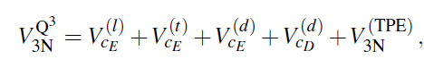
Wave function matching Hamiltonian
N3LO Hamiltonian
V_2N : short range NN interactions
W_2N: GIR restoration term for V_2N
V_2N,WFM : difference from H_s
W_2N,WFM: GIR restoration correction to V_2N,WFM
V_3N : contains short range 3N interaction parameters(to be fitted)
and two pion exchange correction to 3N

Slide 28

BE/A from WFM
Preliminary

Slide 29



Charge density from WFM
Preliminary

Slide 30

Charge Radius
Preliminary

Slide 31

Nuclear/Neutron Matter
Neutron matter:
A=4~80
box size 6.6 ~ 13.2 fm.
Nuclear matter:
A=4 ~ 160
Box size 7.92~9.24 fm.
Preliminary

Slide 32

Carbon isotopes

Slide 33

Carbon and Oxygen
Preliminary

Slide 34



Dripline for unitary Fermions
Full chiral EFT calculation are very expensive for many fermions.
Unitary Fermion Gas :
A strongly coupled conformal system
Physically interesting multi-fermion system with simple interaction
p $\cot{δ}=0$ : Unitary limit
→largest possible scattering amplitude. Infinite scattering length.
( Realistic nuclear force is close to unitary limit.)
Universality of unitary limit of many fermion system
→ Bertsch Parameter

Slide 35





Unitary limit Hamiltonian
1S0 NN scattering phase shift is fitted for unitary limit .
In cubic and BCC lattice
N=66 neutrons (33 spin up, 33 spin down)
L = 4,…, 10
Cubic lattice
BCC lattice

Slide 36
Unitary Fermions under external potential
Unitary Fermion itself does not form a bound nuclei
→ Introduce an external spherical well potential
Can we find a relation between spherical well shape and dripline?
Separation energy have to be calculated accurately
→ Use an re-weighting method to reduce error in separation energy.
( Compute A and A-n system at the same-time in MC
to include correlation in the error estimation.)
Unfortunately, realistic mean-field potential is rather expensive.(too many fermions for dripline in Unitary limits.)
→ limited to shallow external potential.
Try to see the dependence on parameter : y0 = m R^2 V
(Work in progress. Only preliminary results)

Slide 37

Separation energies
Lattice spacing 100 MeV
Spherical well
radius~ 4fm
Preliminary

Slide 38


Unitary Fermions under external potential
Preliminary

Slide 39








V0=8MeV density contour
Preliminary

Slide 40








V0=10MeV density contour
Preliminary

Slide 41
Summary
Wave function matching method seems to be promising
New method to improve the N3LO calculation of NLEFT
Preliminary study shows promising results for wide range of observables in one scheme (same interaction and many-body method)
NN scattering
Binding energy (from 3H to 40Ca)
Symmetric Nuclear matter
Neutron matter
Dripline of Oxygen isotope.
Carbon excited states
Further investigation on the finite volume effects is on-going.
Also, Carbon isotopes, odd Oxygen isotopes, Cluster structure, excited states will be studied.

